Slide 1
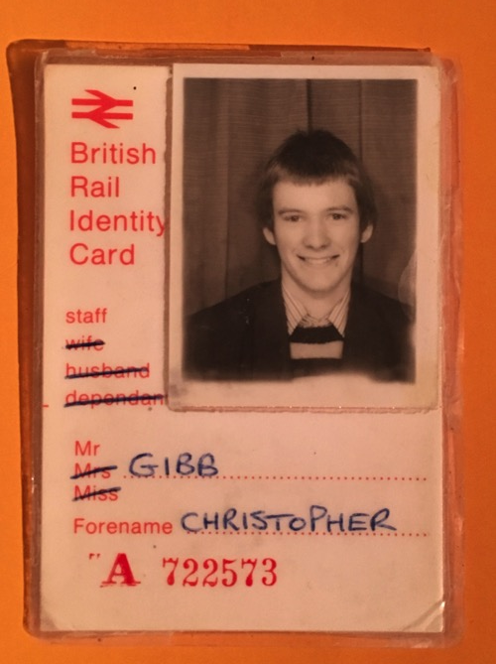
Lifetime of Change
A railwayman’s journey through UK rail privatisation.
Chris Gibb
Speaking in a personal capacity
Currently:
Non-Executive Director, Department for Transport Operator of Last Resort Holdings Ltd.
Recently:
Chief Executive, Scottish Rail Holdings and Chairman of ScotRail
Advisor, Transport for Wales
Advisor, HS2
Non-executive Director, Network Rail
Advisor, Texas Central Railway
Chief Operating Officer, Virgin Trains
23rd June, 2023
PAGE 1

Slide 2
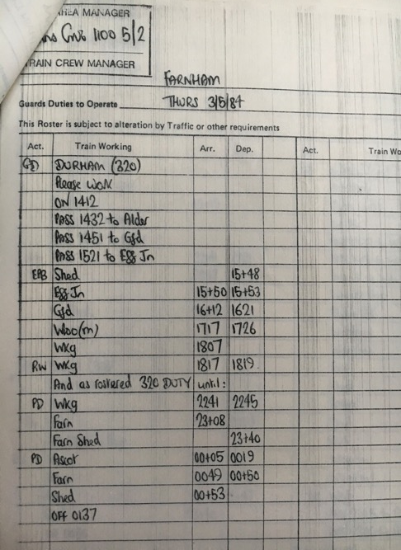
British Rail
Started from school as
a junior clerk age 17,
in 1981
First jobs were
rostering and planning
of traincrew in the
London area
PAGE 2

Slide 3
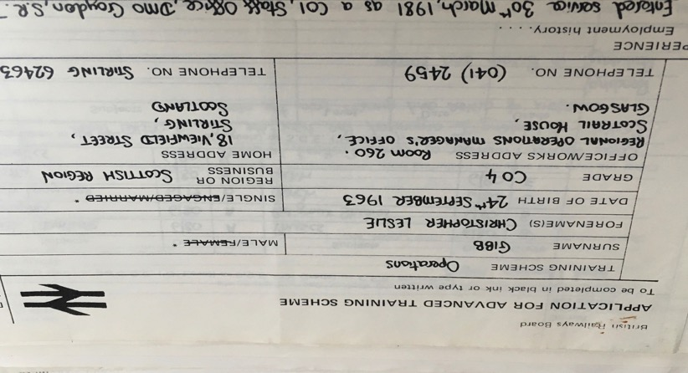
Age 21 moved to Scotland, and was selected as a staff entrant for a year long “advanced training scheme” in Glasgow. Fantastic opportunity !
PAGE 3

Slide 4
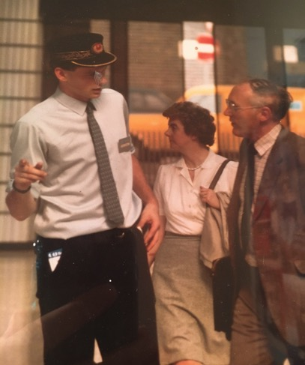
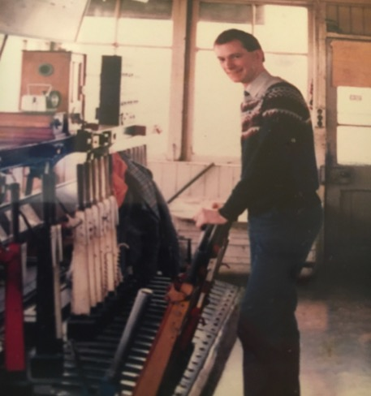
British Rail taught me every part of the “whole railway” – operations, signalling, station management, passengers, finance, on call
PAGE 4

Slide 5
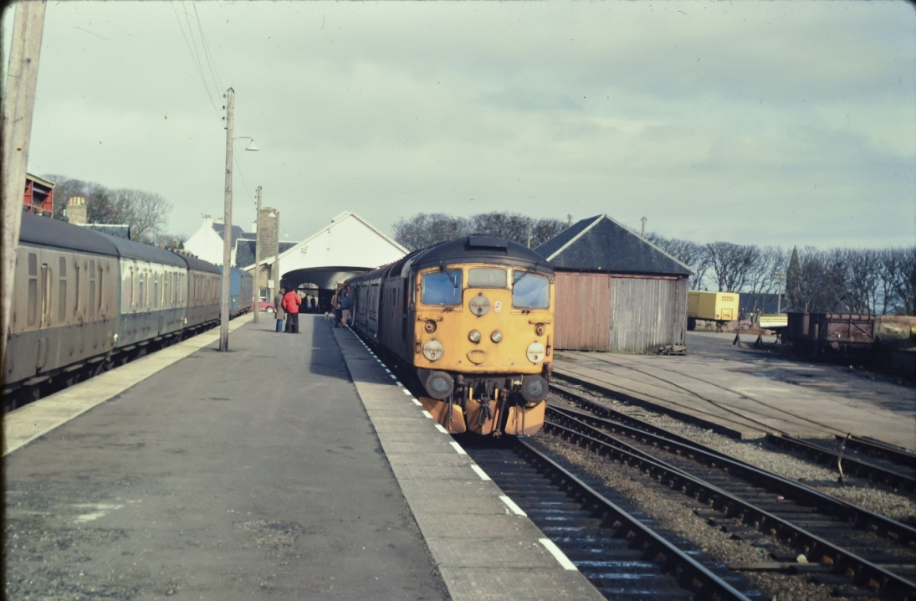
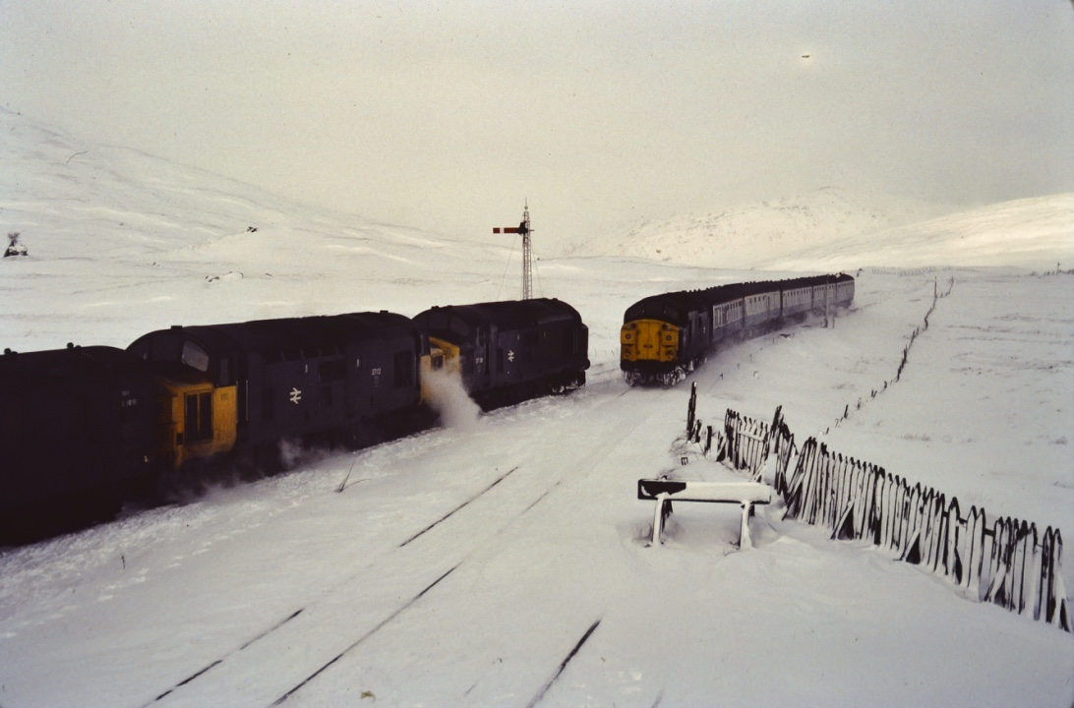
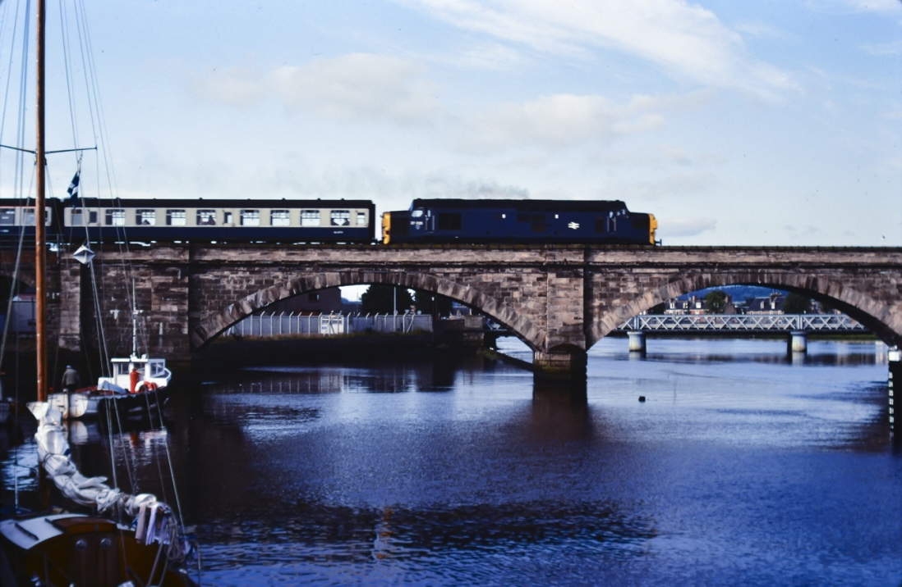
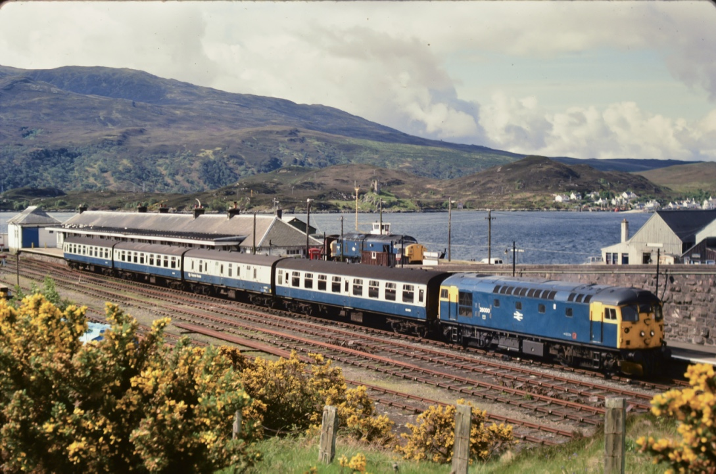
Trainee managers were obliged to explore and learn….

Slide 6
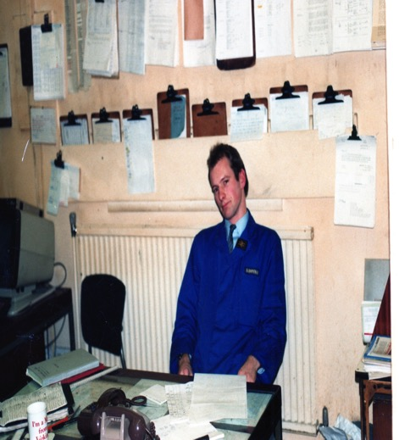
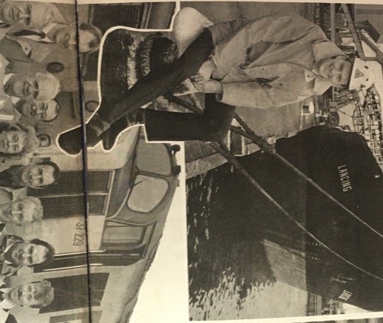
I went on to learn about supervision, people, employee engagement, management, freight trains, newspaper trains to Lairg, travelling post offices to Perth, absolute block working at Stirling North, tokenless block at Blair Atholl, carriage cleaning at Cowlairs and many other railway activities.
Junior management roles in Scotland followed: Train Crew Supervisor, Glasgow Central; Train Crew Manager, Ayr and Freight Operations Manager, Ayr
PAGE 6

Slide 7
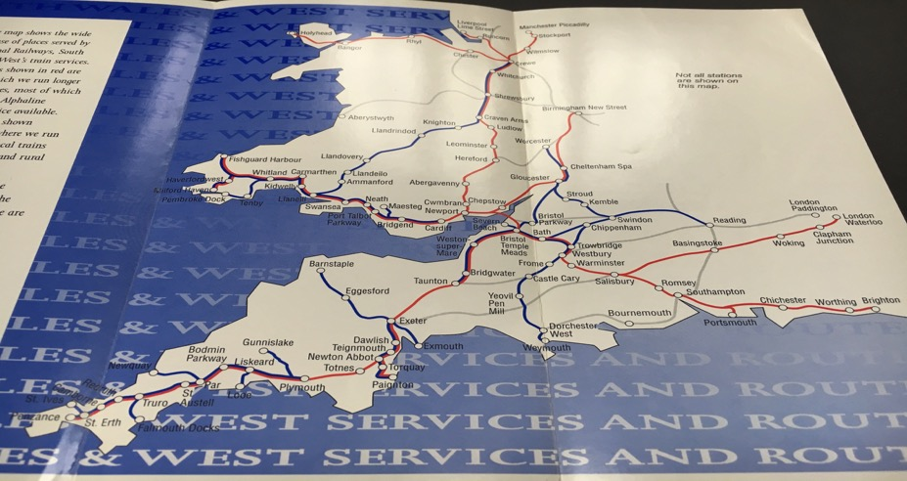
1990, age 27, I moved to Swindon to manage a regional passenger operation. British Rail was being devolved into “Sectors”- “Regional Railways”.
PAGE 7

Slide 8
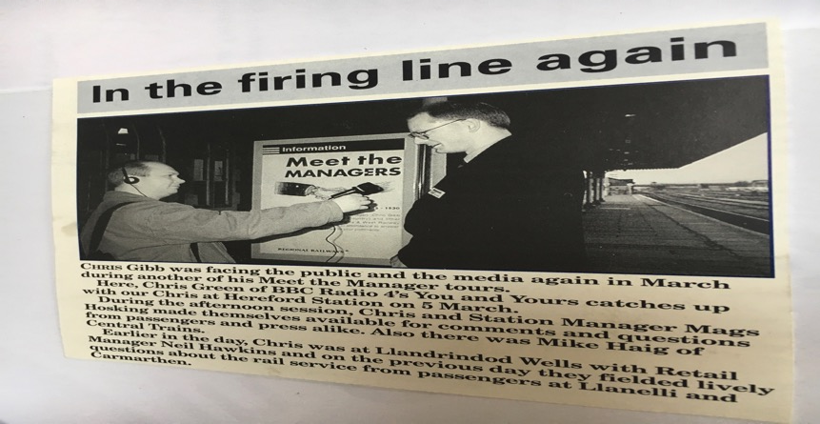
Regional Railways moved decision making from “headquarters” to local level: quite often junior managers like me. This brought accountability for decisions, and bottom-line responsibility by route.
PAGE 8

Slide 9
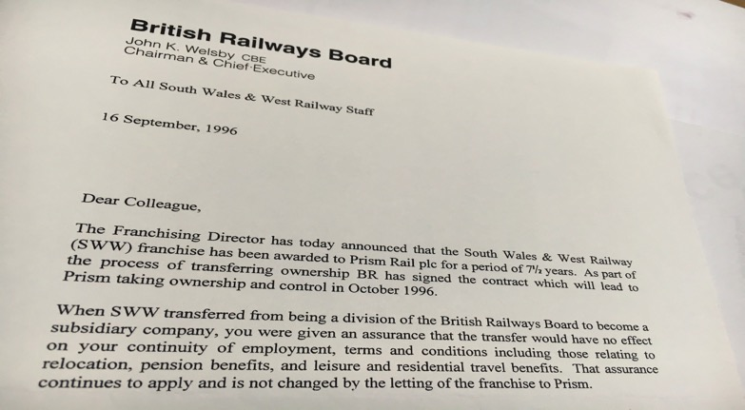
Change wasn’t fast enough for politicians. 1994-1997 saw very fast “privatisation”. It was not done in the way recommended by British Rail’s Board, but nevertheless managers like myself spent a lot of time preparing the industry for sale (into c. 130 separate entities) and constructing the framework by which we would operate – Network Code / Track Access Agreements, Rail Settlement Plan, ATOC, asset transfers, staff TUPE, union negotiations etc.. National pay and conditions bargaining with trades unions ended and each company started doing its own negotiations.
PAGE 9

Slide 10
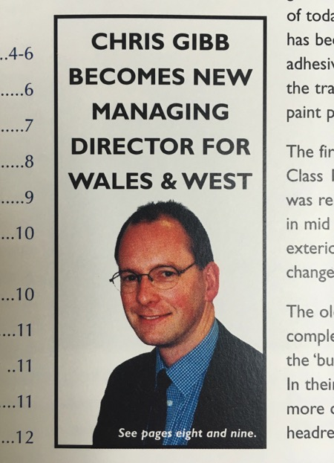
Some people retired.
Some people moved
jobs to try to avoid it.
Others took new
opportunities:
Operations
Director in 1996, then
MD at age 35, in 1998.
To our surprise the
private sector
needed us !
PAGE 10

Slide 11
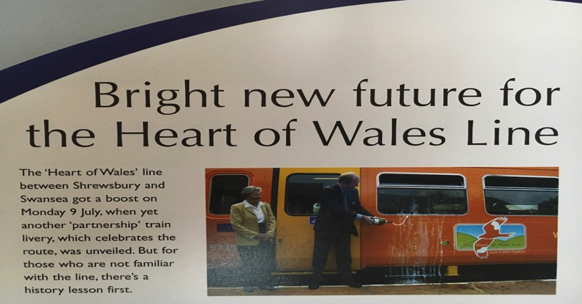
The accountability and devolution of responsibility quickly grew. We grasped every opportunity and nobody from above stopped us. For example for the first time we had complete freedom to apply any train livery we considered would benefit the business.
A train operating company is small enough for the MD to be known to most staff, to discuss ideas, solutions, passenger opinions and opportunities.
PAGE 11

Slide 12
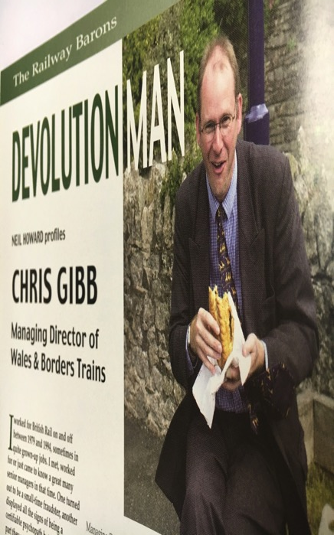
The UK has changed, with government devolution to Wales and Scotland. The creation of the Welsh Parliament led to creation of the Wales & Borders train operator in 2001: better able to respond to the new Welsh government’s priorities.
In 2020 Transport for Wales took ownership of the South Wales “Valley Lines” from Network Rail, and this infrastructure (172km) is now maintained and operated by private company Amey on their behalf. In 2021 Transport for Wales took over operation of the trains from Keolis/Amey and now owns the operator “Transport for Wales Rail”.
The Valley Lines is currently seeing a £738m transformation into the South Wales Metro network, with Stadler tram – trains (battery, catenary and diesel generator units) operation using “discontinuous” electrification. This is a high priority scheme for Wales to drive economic regeneration for 1.5m people living in the former mining valleys of South Wales.
A £136m contribution to this scheme is coming from the EU’s European Regional Development Fund.
PAGE 12

Slide 13
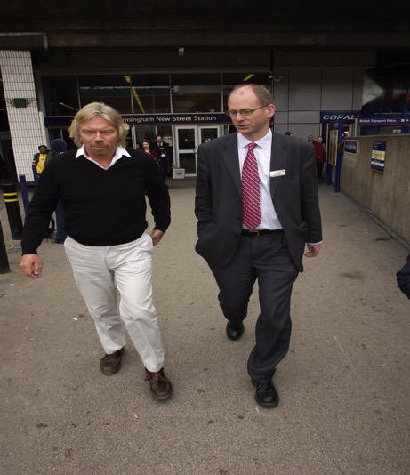
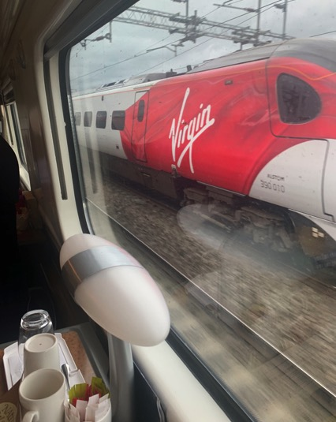
All change in 2003: my former ScotRail boss, Chris Green, asked me to join Virgin Trains as MD, Virgin Cross Country, to lead a recovery from “Operation Princess”. Sir Richard Branson was in charge.
PAGE 13

Slide 14
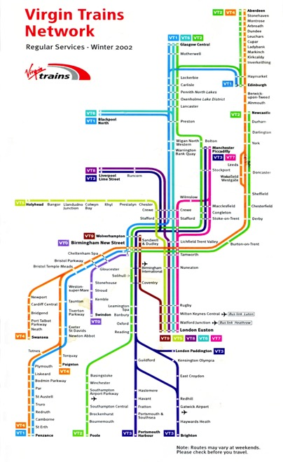
This was a much bigger job ! The network covered most of the UK.
The company had two franchises: West Coast and Cross Country. A completely new fleet of Bombardier Voyager trains was introduced, which Bombardier maintain, and our staff numbers doubled !
PAGE 14

Slide 15
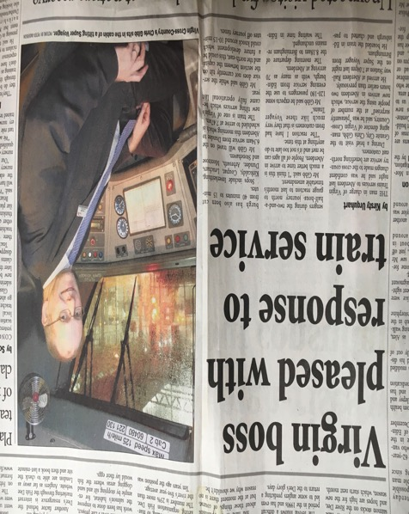
High expectations !
Passenger numbers doubled between 2003 and 2007, and the new trains performed well but were soon full ! There was a complete change in customer service led by many more female employees. The Virgin culture was that every member of staff was encouraged to engage, challenge and contribute.
PAGE 15

Slide 16
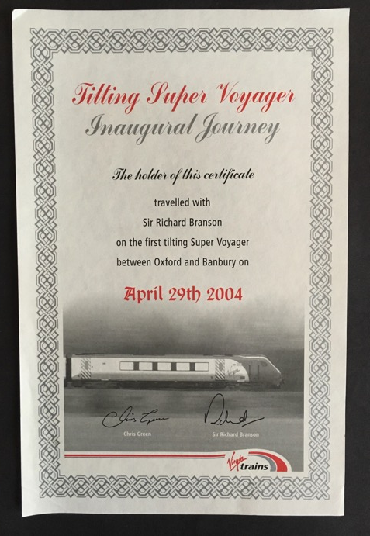
Tilting trains: a first for the
UK. BR had tried and failed:
“Advanced Passenger
Train”. Virgin succeeded.
All achieved by experienced railway
people, but exploited by a
new breed of Virgin
marketing and yield
management people. Now
taken for granted London –
Manchester / Birmingham /
Liverpool / Glasgow.
PAGE 16

Slide 17
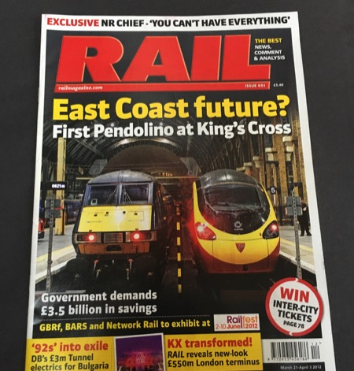
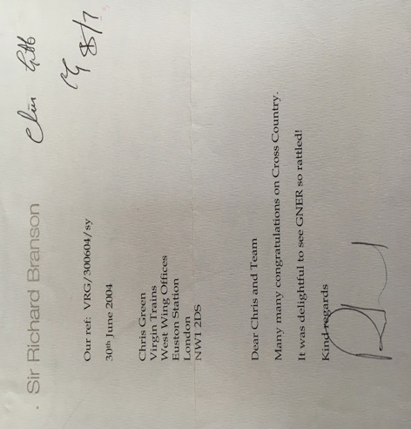
Competition and passenger choice: competition for franchises, between services and routes, and to be the best ! Competition drove innovation and improved standards, but franchise competition cut costs and sometimes had unintended consequences. Competition also for the best employees, and to be the best place to work.
PAGE 17

Slide 18
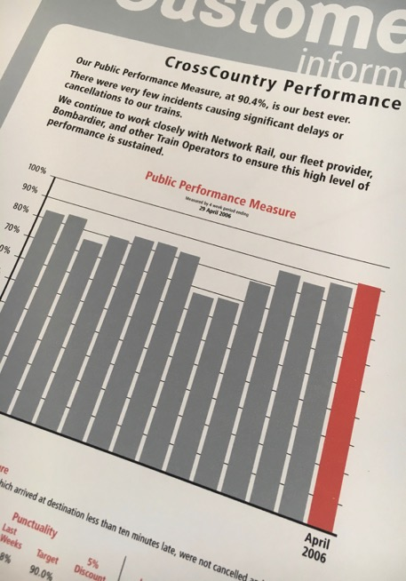
Relentless focus on punctuality, driven by passenger revenue, “schedule 8” payments to and from Network Rail, passenger compensation for delays and “league tables” with media scrutiny.
Detailed analysis, accountability and intervention as never before.
Even the Finance Director is interested in performance, and a new science of trying to predict future performance emerges, both in bidding for franchises and for annual financial budgets.
PAGE 18

Slide 19
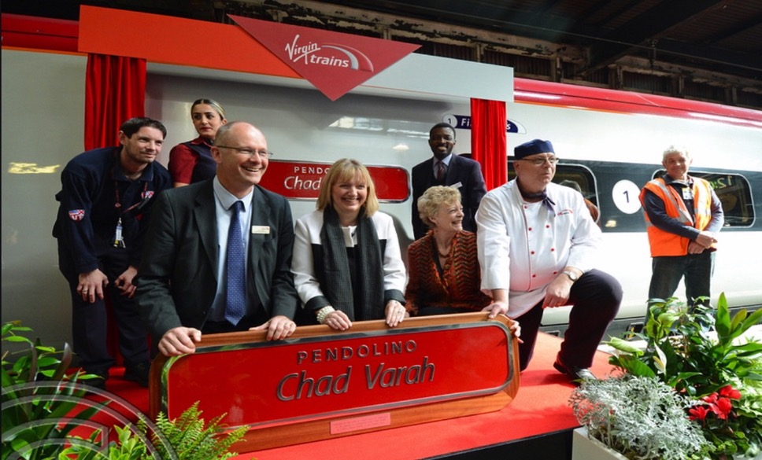
As well as competing, the industry learned how to collaborate to improve the overall railway. National initiatives such as the Samaritans suicide prevention programme save lives and improve performance.
Chad Varah founded the Samaritans.
PAGE 19

Slide 20
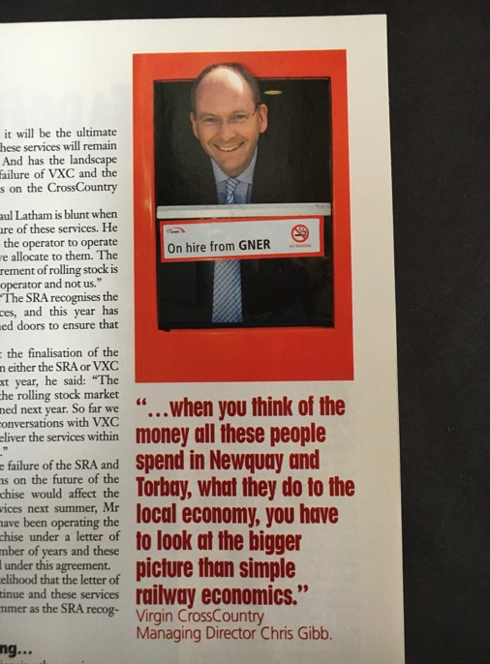
As passenger numbers grew UK rail plays a new role: supporting the economy, creating jobs and housing.
No longer seen as just a “cost”: Now everyone wants more trains, more capacity, more marketing….
PAGE 20

Slide 21
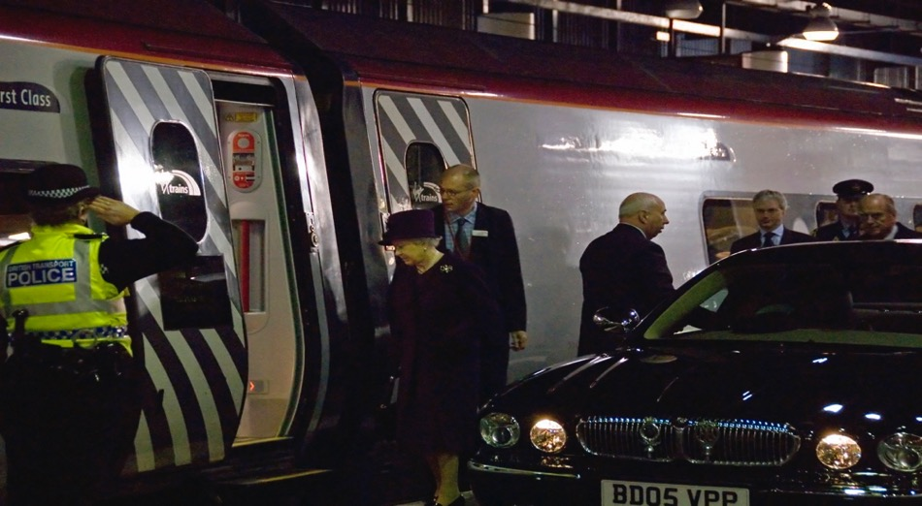
Running a railway really matters and is fun ! Meeting passengers is always interesting: here I am escorting Her Majesty the Queen and the Duke of Edinburgh onto one of our trains.
PAGE 21

Slide 22
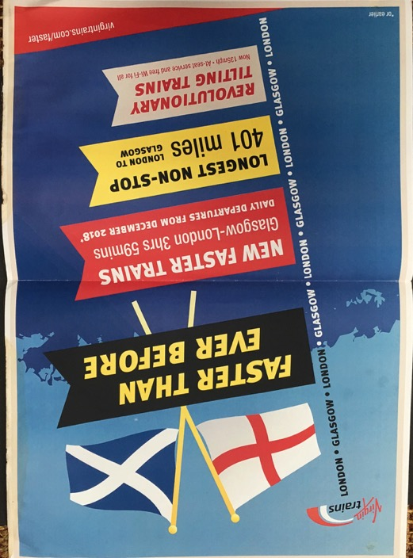
Its not about simply delivering a contract ! Railway professionals must give governments ideas and solutions and be imaginative (it helps if governments are willing to listen too). People love the tradition and ambition of trains, and we can make more of this with ambitious vision.
PAGE 22

Slide 23
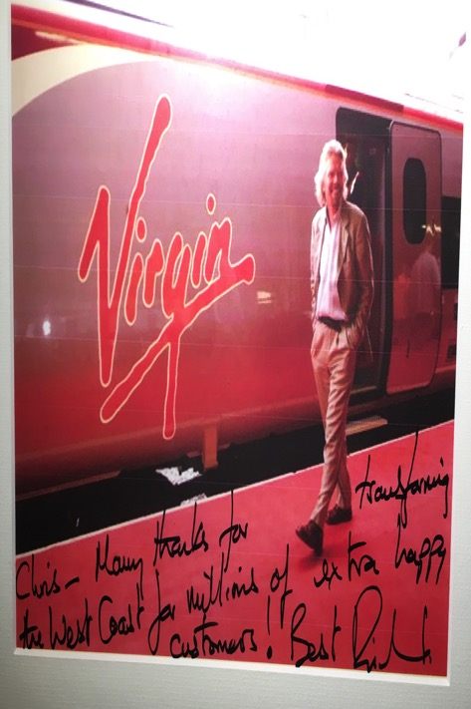
2013 – After ten years with Virgin, running first Cross Country and then as Chief Operating Officer for West Coast, I decided to retire from a full time executive role at 50.
PAGE 23

Slide 24
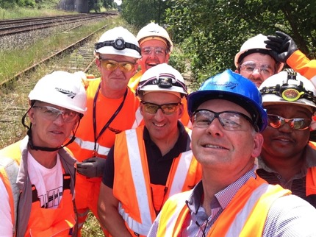
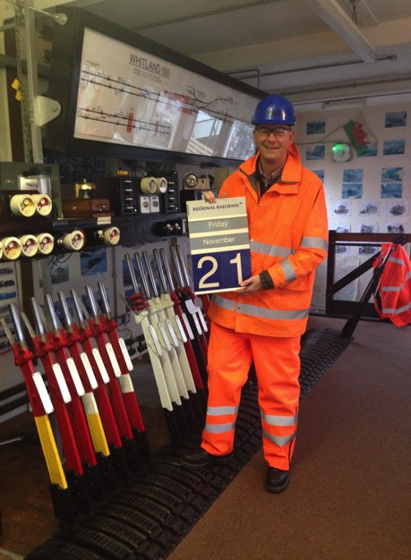
I joined the Network Rail Board as a Non-Executive Director 2013-2019.
I chaired Network Rail’s Safety, Health & Environment Committee and the Property Board.
This was a part time role, allowing me to do other things that interest and excite me, such as Texas Central Railway.
PAGE 24

Slide 25
Network Rail Safety – Lost Time Injury Frequency Rate
NB: Network Rail always includes both employees and contractors in safety data
PAGE 25

Slide 26
Passenger growth 1830 – 2020 (to covid)
2000
1948-1995
Nationalisation
(British Rail)
We have seen huge passenger volume growth on our mostly 120-200 year old railway network.
In my career I have seen the low point and the high point.
Freight volume has increased by 19% since 1999, excluding coal traffic which has almost ceased due to a change in electricity generation strategy.
1923-1947
The Big Four
1995-date
Privatisation
1750
1500
1250
Passengers (Millions)
1000
750
500
250
0
1830
1840
1850
1860
1870
1880
1890
1900
1910
1920
1930
1940
1950
1960
1970
1980
1990
2000
2010
2020
PAGE 26

Slide 27
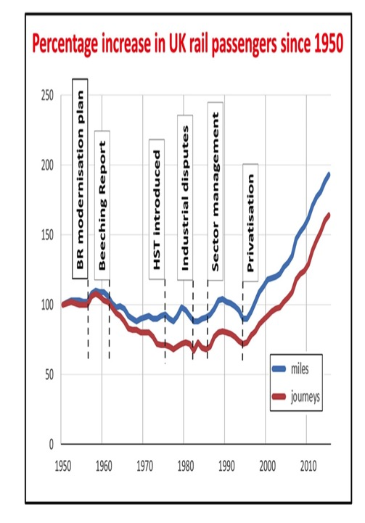
British Rail had ambitious plans and investment, but it took privatisation and devolution of management to reverse the downward trend.
Current fares system and revenue allocation created by BR in the 1980s
and is “market led” reflecting competition from air, coach, bus, car – not “pence per mile”.
In 1997 fares system revealed “warts and all” to passengers, analysts and retailers by arrival of Trainline internet bookings, created by Virgin. Fares structure complex and unsuited to internet, but very difficult to change due to inevitable number of “losers” and increases regulated directly by government decision.
Despite criticism, the current fares structure has supported the huge growth in passenger numbers and revenue since privatisation.
PAGE 27

Slide 28
Performance decline / passenger satisfaction
Overall Passenger Satisfaction (NRPS) and PPM
But we became the victim of our success – passenger volume growth impacted on overcrowding, punctuality and passenger satisfaction. Pre covid we were close to the limit of what our ageing system could cope with, choices had to be made and we cannot please everyone. The ability of railway professionals to run the system was tested as never before. Until covid, of course….
95%
93%
91%
89%
87%
% Satisfied With Overall Journey (NRPS)
85%
PPM
83%
NRPS
81%
79%
77%
75%
2004-05
2005-06
2006-07
2007-08
2008-09
2010-11
2011-12
2015-16
2009-10
2016-17
2012-13
2017-18
2013-14
2014-15
Calendar Year
PAGE 28

Slide 29
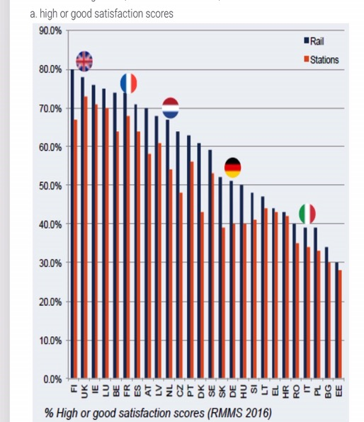
On every independent measure the UK compares well with other European railways, but the expectations of government, passengers and the media are hard to meet, and always rising.
There is plenty of scope to raise UK satisfaction further with better punctuality, more capacity, station improvements and fares simplification. 2019/20 saw more new carriages introduced in one year than ever before.
PAGE 29

Slide 30
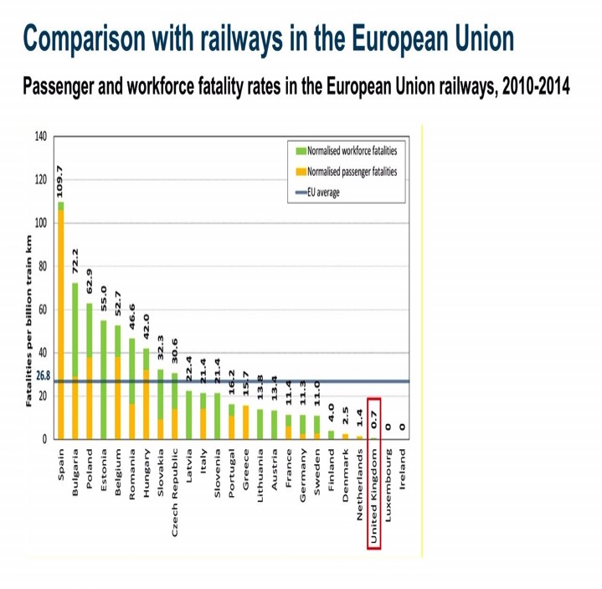
After several major accidents in 1995-2002, UK railway safety has steadily improved. Clear management accountability through the safety certification process, network wide reporting, analysis and publication of data by RSSB, investment and the independent regulation by ORR have all played a part.
PAGE 30

Slide 31
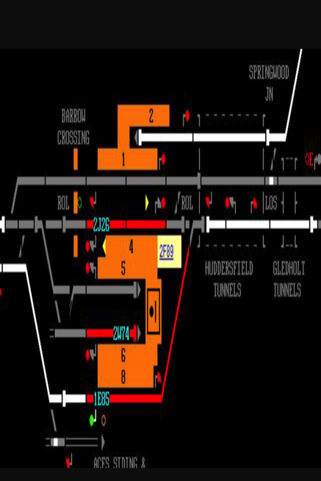
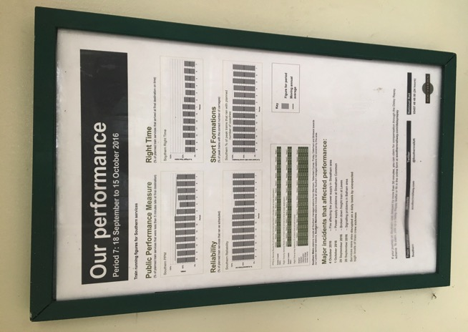
Trains are people not numbers !
PAGE 31

Slide 32
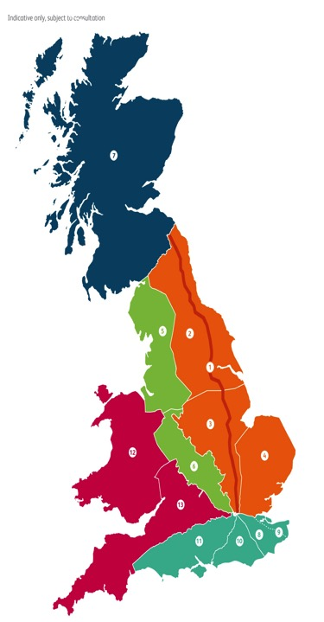
The future for managing the UK rail is greater regional devolution and “less headquarters”.
Closer relationships between Regions, train operators and governments, led by accountable “Regional Directors”.
The UK is a small and mostly crowded island, with a growing population. Making the most of our existing railway network is our priority, as building new railways here is expensive, contentious, slow and difficult – HS2.
Scotland
North West & Central
Eastern
Wales & Western
Southern
PAGE 32
Notes:
A key way we will succeed is through greater devolution.
Devolution can give us tools, capability and authority to deliver for passengers, TOCS, FOCS and funders.
Why devolution - because there is compelling evidence that people work best when they have a clear sense of purpose but also the ability to get on with their jobs. That doesn’t mean anarchy or even democracy but it does mean streamlining decision making, giving autonomy when we can and working closely with colleague in the industry. Decisions are best taken by people who have direct line of sight to the full consequences of those decisions. Projects developed and delivered remotely from the users are rarely a huge success!
Its also about being honest with each other. We have talked devolution for more than 6 years but in reality too much power and influence has rested in the centre or in HQ.
Another key benefit of devolution is allowing us to work more closely with Train operators, our customers. Everyone I have spoken to from the SoS to maintenance gangs believe passengers would be better served if we worked more effectively with operators, removed some of the barrier, simplified decision making and sorted out our contractual disputes. Devolution allows us to adapt to methods of working that work for the end user.
Phase one of the Putting Passenger First programme starts on 24 June - five new regions set up.
Route teams and IP region teams and parts of System Operator will transfer to regions.
Two service directorates – Route Services and a new Network Services. The network-wide functional teams – HR, Finance, Communications, Property to serve the regions and routes, and make sure they have all they need.

Slide 33
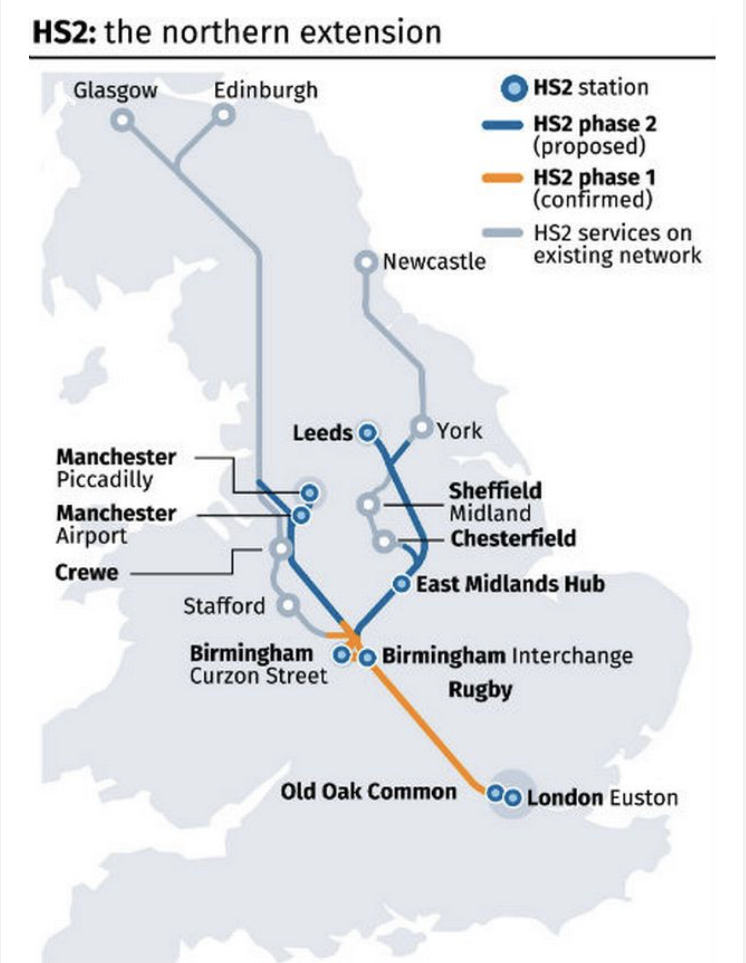
HS2 to come 2031 and beyond ? – phase 1 under construction now

Slide 34
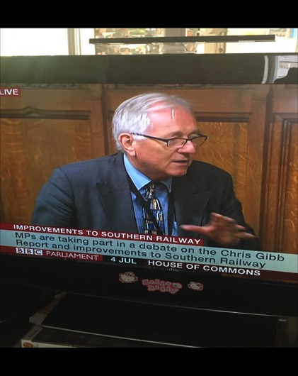
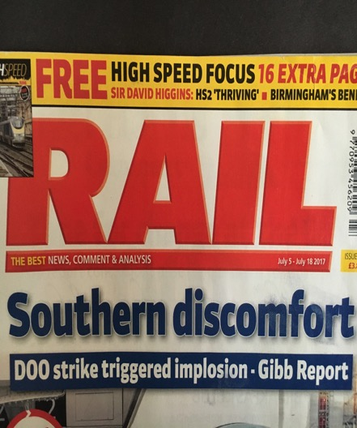
The system is running at full capacity, and is never far away from a very public nervous breakdown as with Southern Railway in 2016. This keeps retired railway people like me busy.
PAGE 34

Slide 35
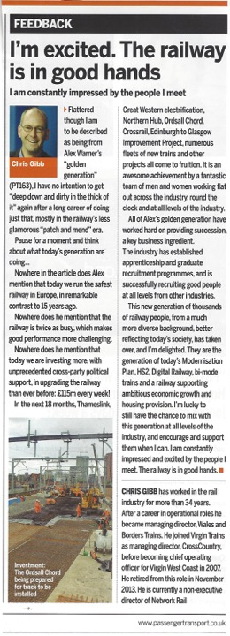
I am an optimist. A good professional railway manager will always be in demand. Especially those that engage effectively with staff and customers. UK train company directors and managers are expected to know their staff, know their jobs and do them if there is a strike.
A younger generation is arriving who challenge what we have done, which we must embrace, and want the passenger experience to be always better. Railways have the answers to the grand challenges of our time: the environment, housing, employment, gender equality, economic improvement, quality of life and national pride. Ownership is not the key to these answers: it is the ambition and engagement of the railway professionals that is !
PAGE 35

Slide 36
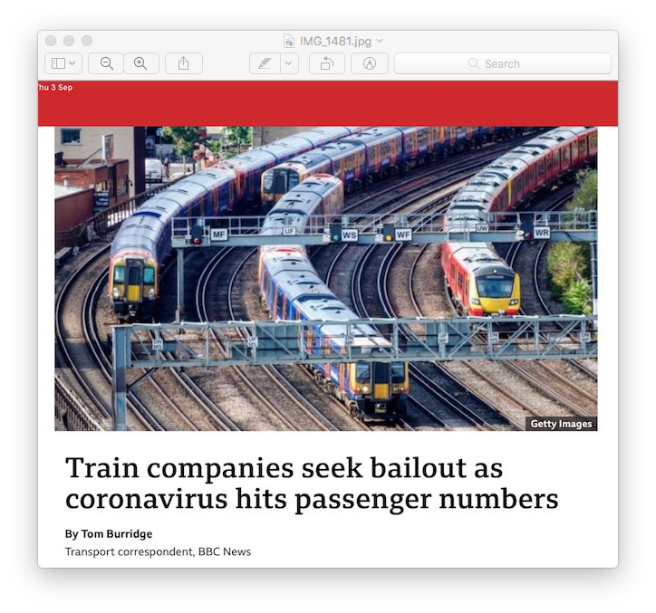
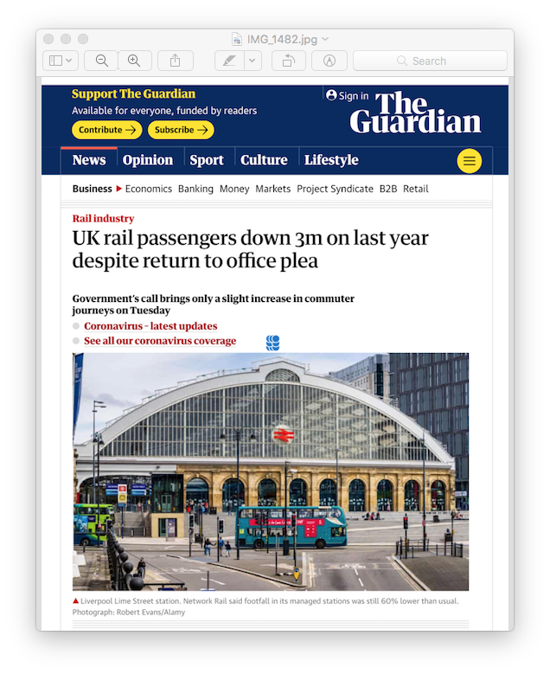
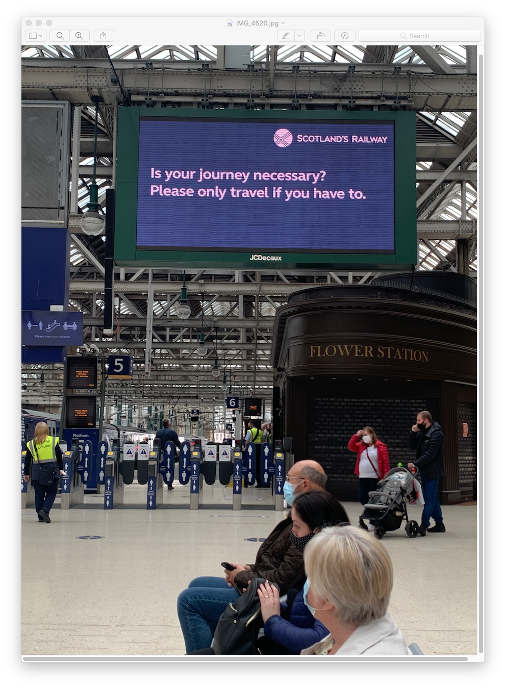
Covid crisis….and recovery ? UK car and leisure rail journeys back to pre-covid, but commuter and business travel are at 50-80% levels. Travel habits have changed, less revenue as a result, but costs rising: the railway must evolve.
“Emergency Measures Agreements”: governments are taking all revenue & cost risk for Train Operating Companies, costing “up to £6bn” according to some sources. What next ?

Slide 37
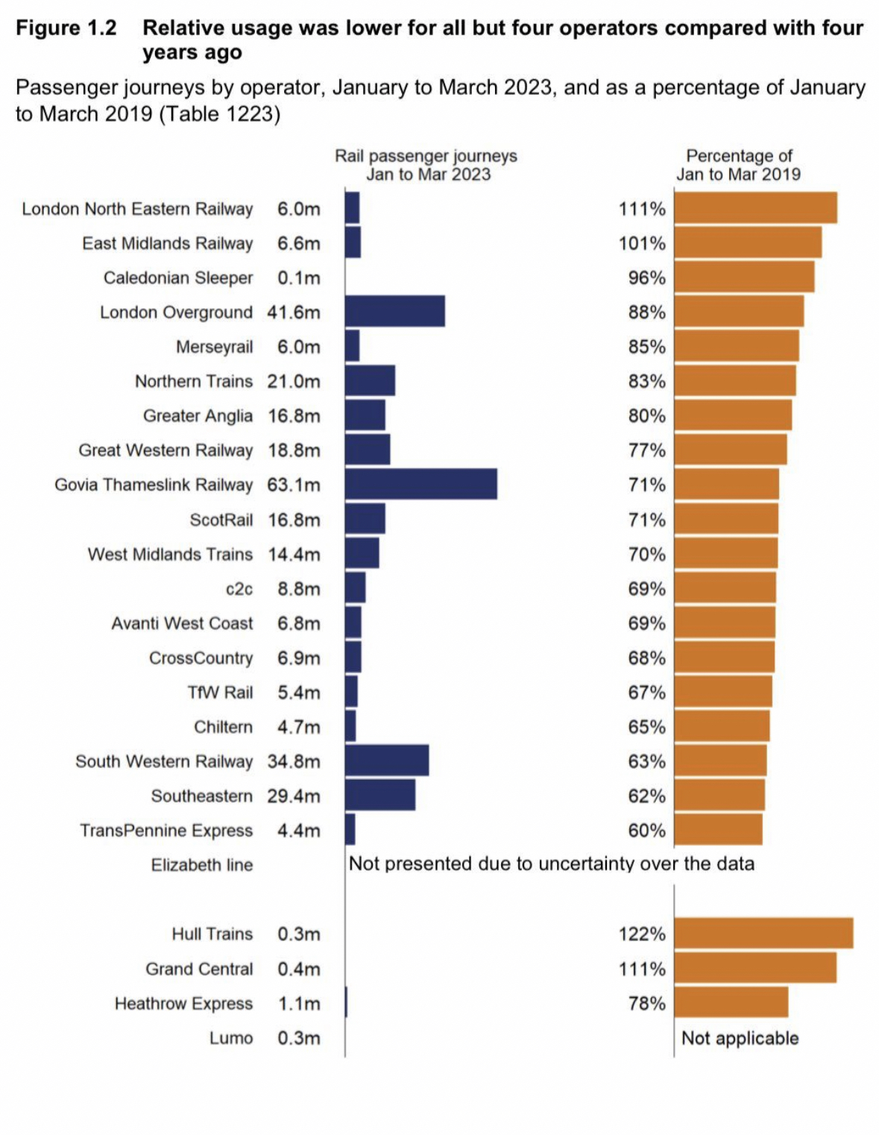
Jan – Mar, 2023 results: travel patterns have changed
Season ticket revenue is just 36% of 2019 levels

Slide 38
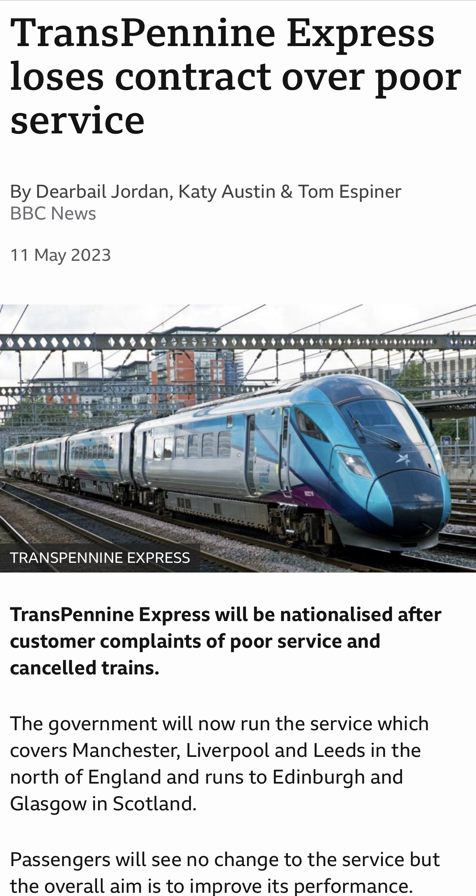
DfT’s “Operator of Last Resort” owns Northern, LNER, South Eastern and Trans Pennine temporarily.
Welsh Government owns Transport for Wales.
Scottish Government owns ScotRail and takes over Caledonian Sleeper next week .
I have been involved with them all.

Slide 39
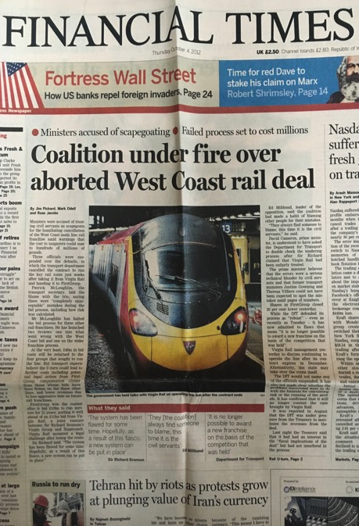
Franchising in its current form “has had its day” in the UK. How best to engage the private sector ? Who leads and is accountable for strategy, network development, franchise specification, revenue risk / opportunity, role of Open Access ? How to balance devolved decision making with national interdependent network ? How to integrate HS2 into that network ? Everyone wants more railway, not less, but how best to continue doing this ? Covid has created a financial crisis for the railway to add to the reform challenge. “Williams-Shapps Report” is driving structural change: “Great British Railways” (GBR) will take over Network Rail, set fares, set timetables and award / control private sector operating concessions in England. A change to law is required and will take time.
PAGE 39

Slide 40
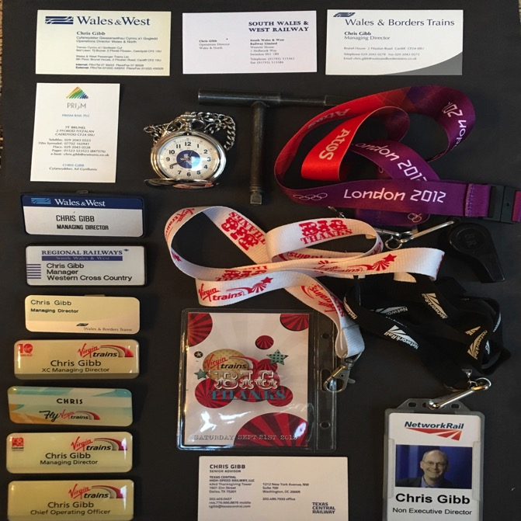
I have loved my 40+ year railway career, and it is not over yet ! I have learnt that the key to a successful railway is for enthusiastic and empowered railway professionals to engage, lead and motivate people, and share their vision of a bigger, better railway.
Such managers must be accountable to staff and passengers for their decisions.
PAGE 40

Slide 41

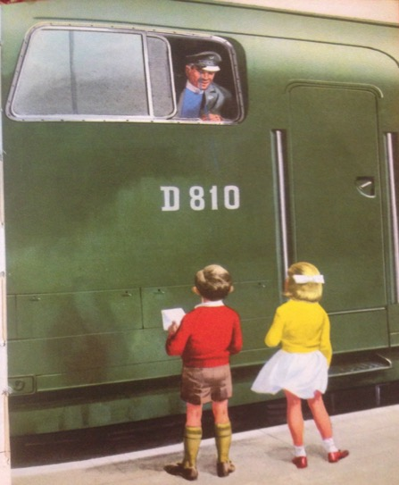
Thank you
The End...questions ?
PAGE 41

