Slide 1
Friends of the Far North Line
Martin Bignell
Scotland and North of England Representative, Rail Freight Group
23rd June 2023

Slide 2
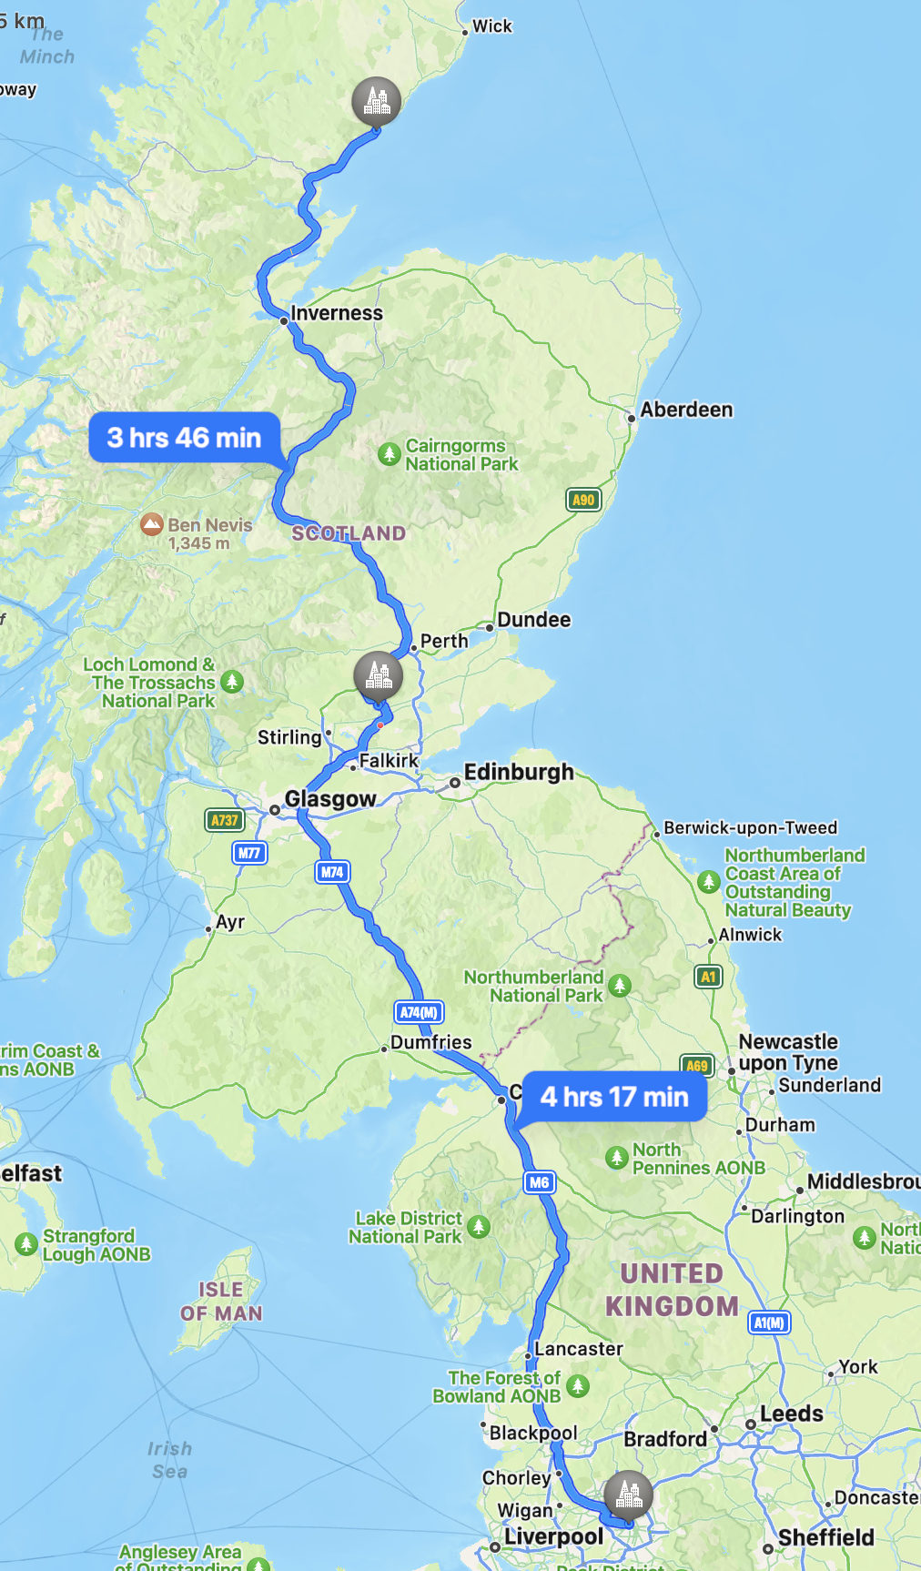
Nice to be close to home!
Driving times…
Every week I could be at a meeting in York, Leeds or Manchester!

Slide 3
Rail freight in Scotland 2022/23
80% intermodal and construction
20% everything else
6 competing rail freight operators
C.300 services per week
94% of services ran on one of the routes linking Motherwell – Mossend/Coatbridge and Grangemouth, up to Perth. Very central belt focused
14% domestic, 35% to Scotland, 52% from Scotland
4.5m lorry miles / 205k loaded lorry miles saved
290k tonnes carbon saved and £109m in user and societal benefits
77% ran WCML, 19% ECML, 4% G&SW (mainly due to Carstairs)
Notes:
69% intermodal, 11% construction, then petroleum, minerals, metals and other

Slide 4
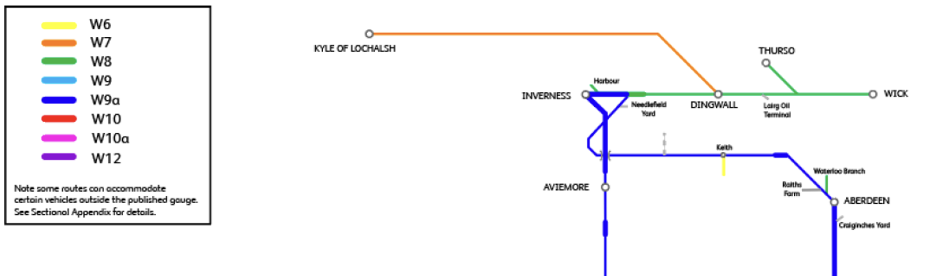
Freight on the Far North Line
Regular decommissioning traffic from Dounraey with NTS / DRS
2020 – Timber trials with Victa Rail Freight
W8, possible for 9’6” 2.5m wide containers on FLA ‘Lowliner’ flat wagons (operated by Freightliner)

Slide 5
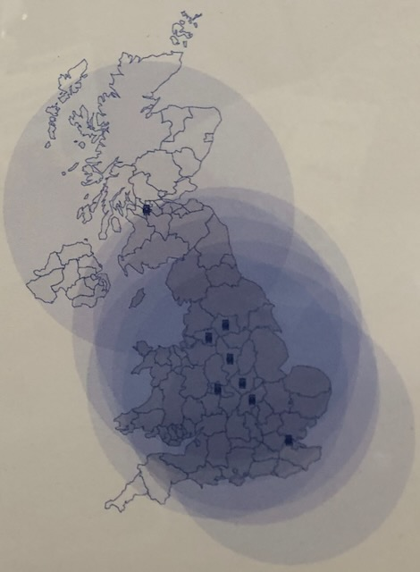
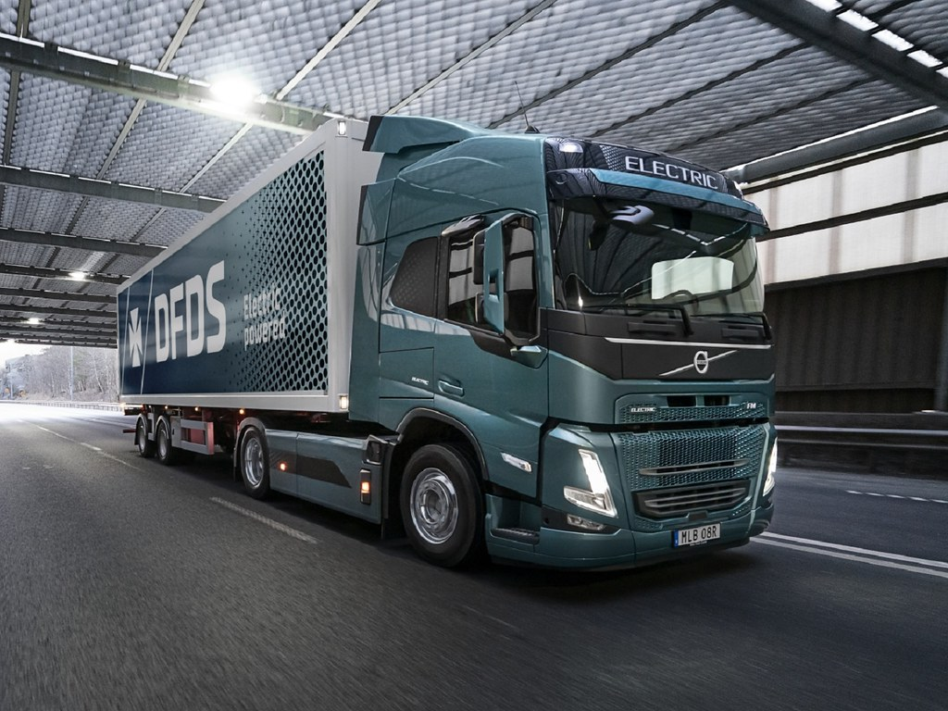
The 2040 Challenge?
2.5 hour recharge @ 250kW DC
9.5 hour recharge @ 43kW AC
Up to 300km range
3 tonne payload loss (battery weight)
3 x price of diesel truck
…the Volvo Electric FH 4x2 today.
Notes:
Volvo Electric FH 4x2 – available today and being trialed by operators.

Slide 6
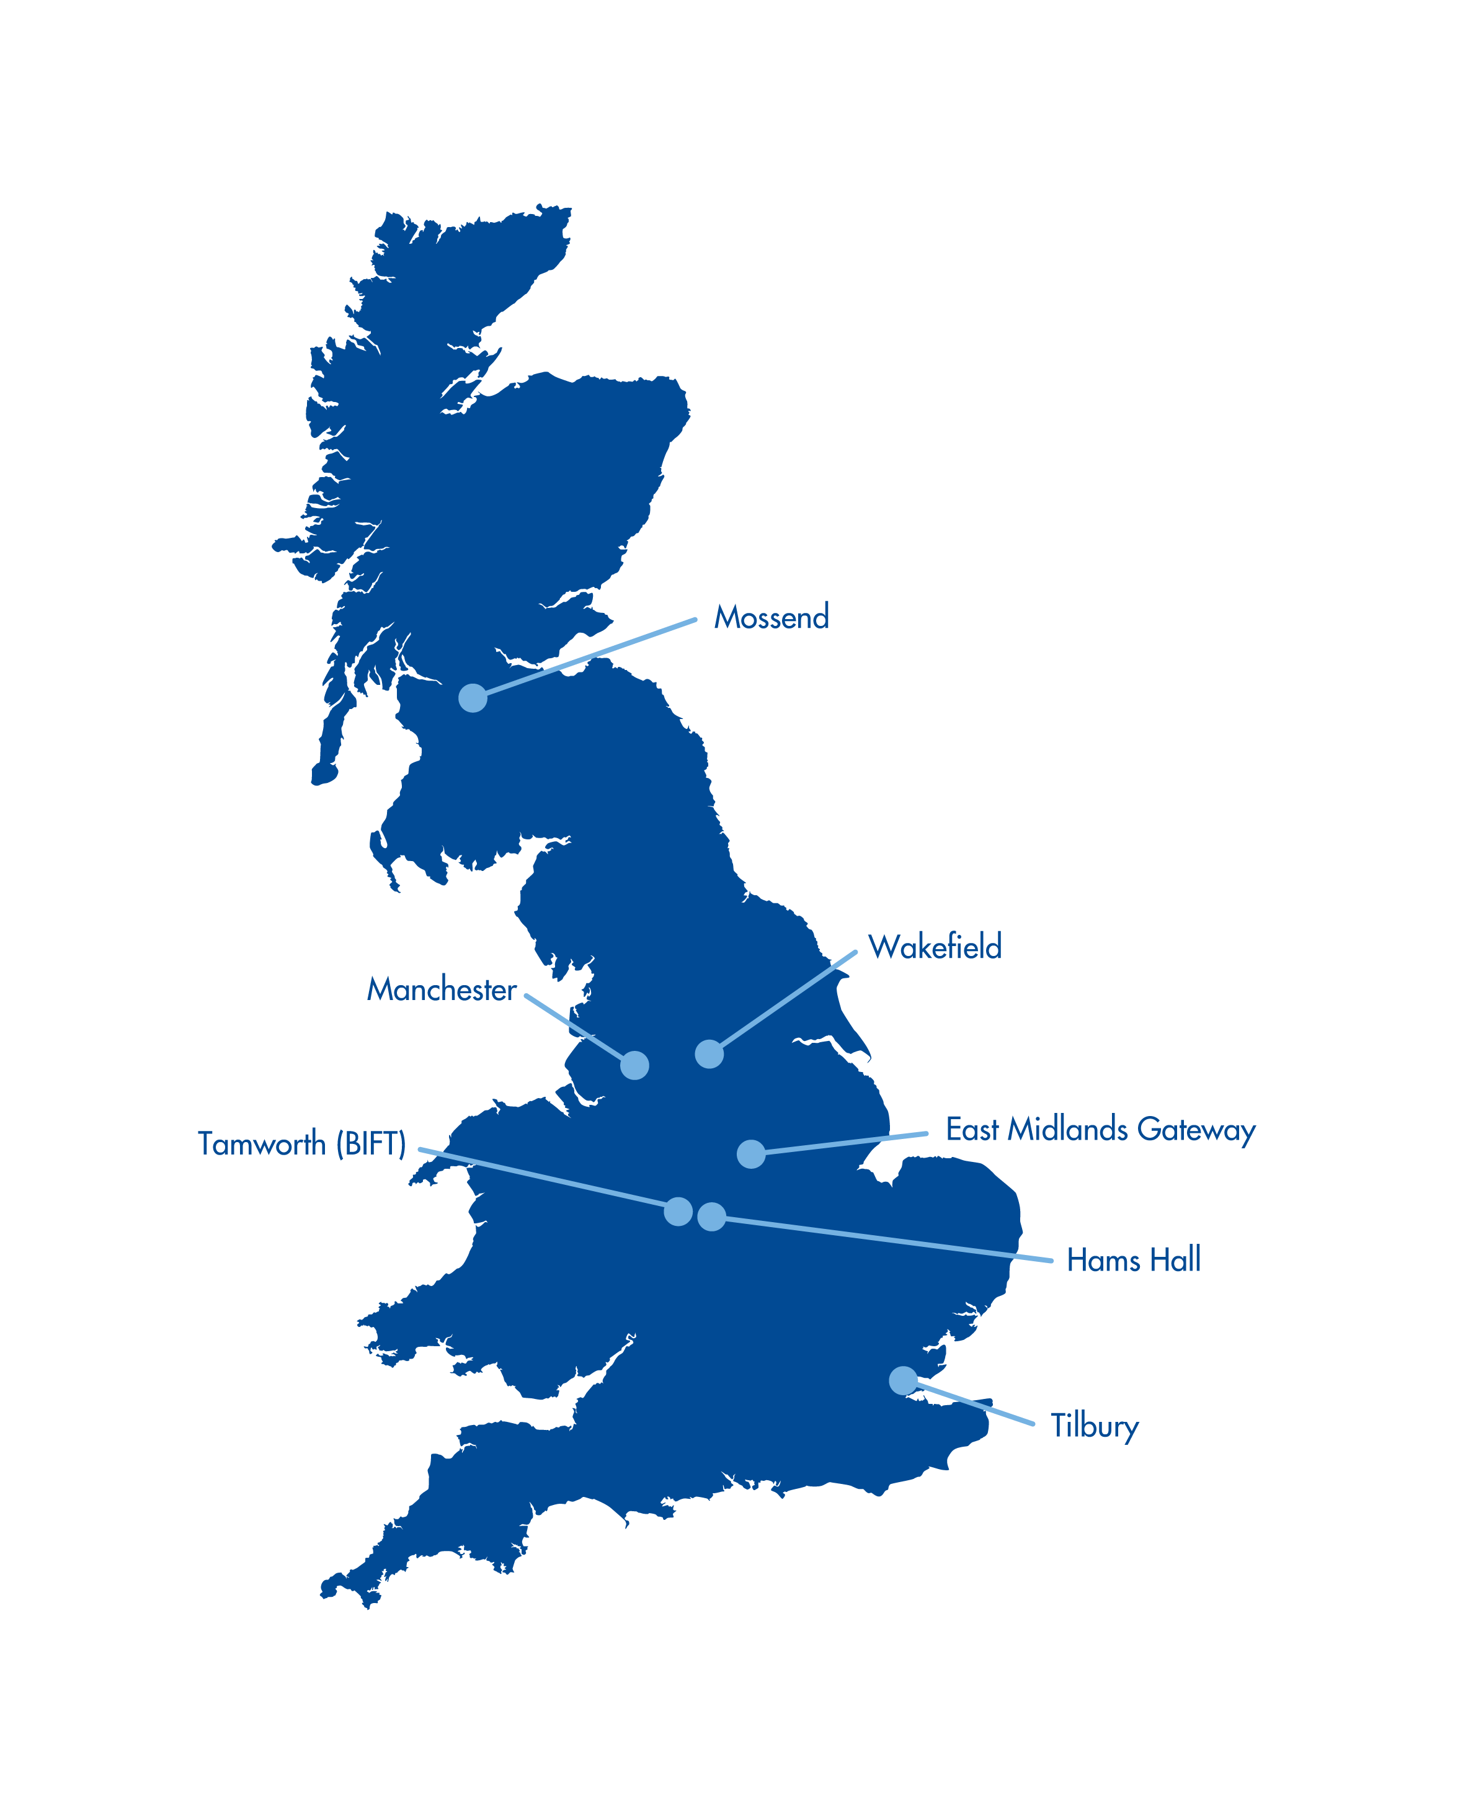
Logistics operators’ interests
Decarbonisation – especially in last 5 years. End customer driven.
Maintaining market competitiveness
Same or better service levels
Driving supply chain cost efficiency
Preparedness to try new ideas – especially larger organisations
Shift in market position – several road operators now aggressively positioning as ‘intermodal operators’ and building networks.

Slide 7
Freight in the Far North?
Caithness – Wick/Thurso
Orkney – two ferry crossings
Probable split: Caithness c.80-100 HGV movements per week, Pentland Firth c.150 per week?
40 trucks per weekday through Helmsdale?
Other than local movements, majority traffic originates Inverness, often as a hub location for origins in Central Belt.
Significant chilled / fresh product moving in 2.55m wide units.
Opportunity to Georgemas Jn to feed ferry and Thurso?
Attractiveness of Kirkwall – Aberdeen ferry, but always constrained capacity.
Notes:
Caithness – Wick/Thurso – c. 45-55 HGV movements per day, c.20 long distance supply?
2019 DfT roadcount data c.220-280 HGV movements per week.
Orkney – 2022 Northlink Statistics
SCST – 65,478 lane metres = 50-75 trucks per week avg.
ABKI – 141,123 lane metres = 130-160 trailers per week avg.
Pentland Ferries carry at least as much as SCST across Pentland Firth – unreported.
Total Orkney freight. c250 – 300+ HGV movements per week (both ways) not unreasonable guess.
Pentland Firth carries most JIT traffic, Supermarket, seafood, parcels
Bulk commodities often on a weekly cycle, Cement, aggregates and similar

Slide 8
Challenges
Total volume and fragmentation
Transferability to rail – product, origin or destination and configuration
Seasonality of some products
Commercial priorities of operators – sweating assets, serving higher margin, higher growth opportunities
Availability of appropriate or efficient wagons
What could be achieved with a ‘Scotland pool’ of modular wagons, and a regionally focused operator??
What could be achieved by building better insight into total freight movements to / from the North?

Slide 9
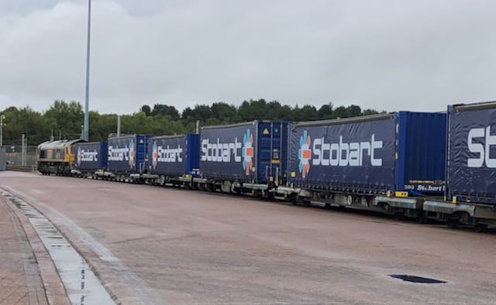

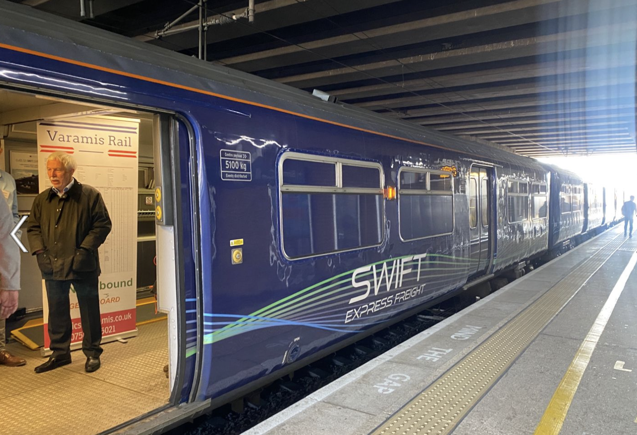
Interesting developments
Curtain sided intermodal – opening up new markets
Financial incentive to use rail freight
£ incentive
New parcel freight offer

Slide 10
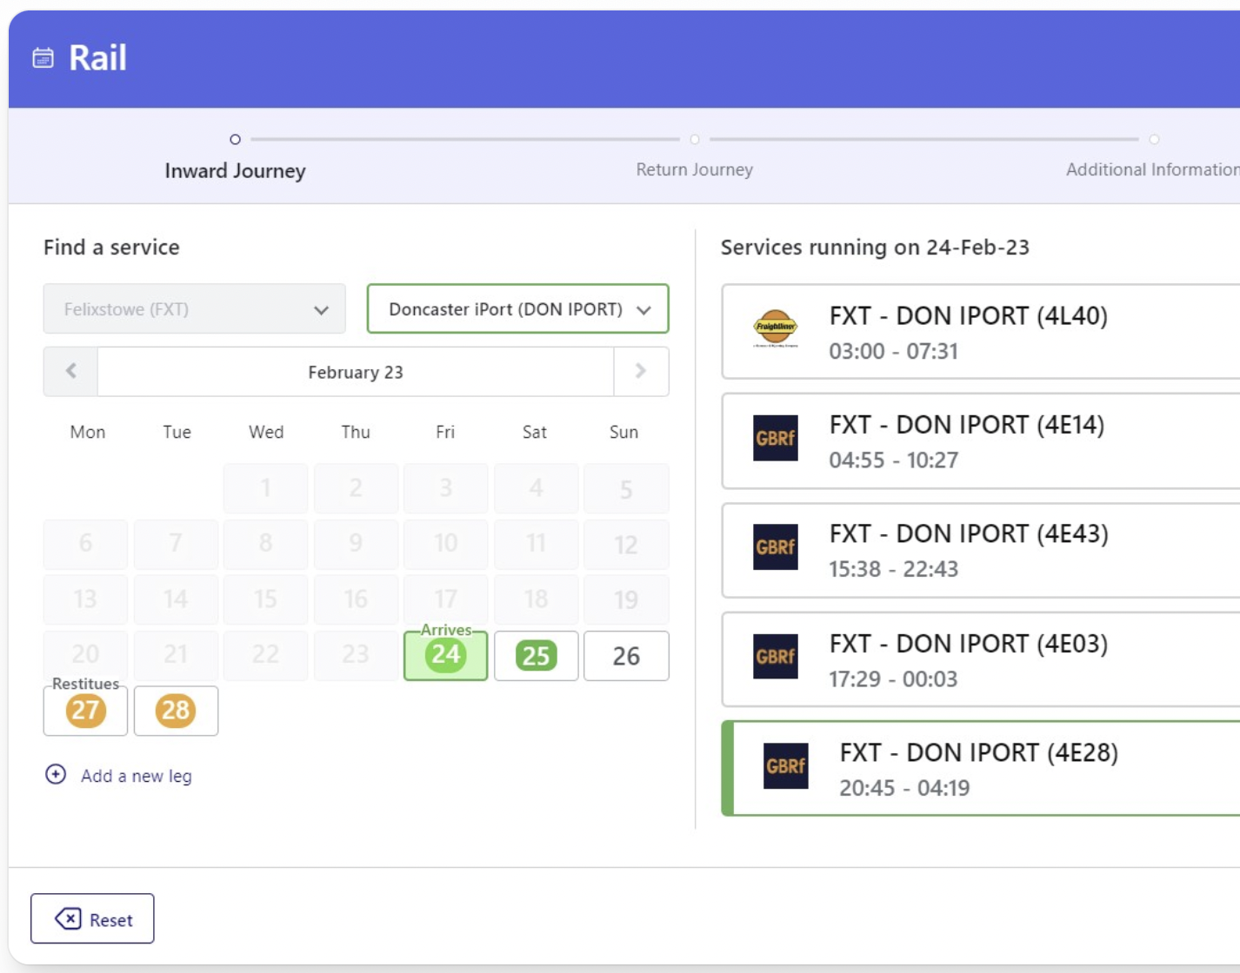
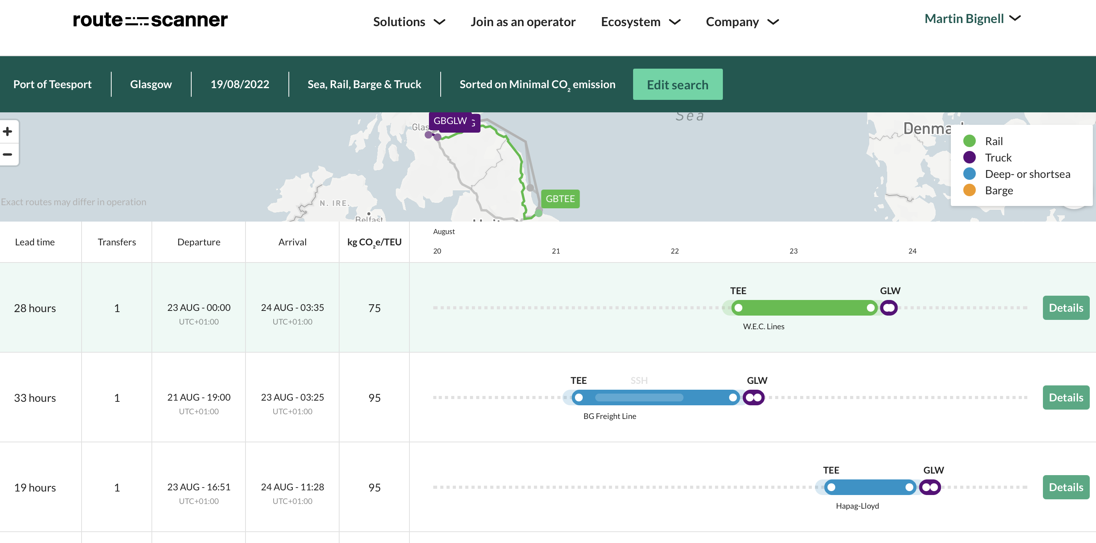
Marketing and Retailing Capacity
Rail X
Route-Scanner
…is a similar approach needed to enable aggregation of traffic and make services easier to buy in the north?

Slide 11
Thank You
martin@rfg.org.uk
www.rfg.org.uk

